Slide 1
8051 ADDRESSING
MODES

Slide 2
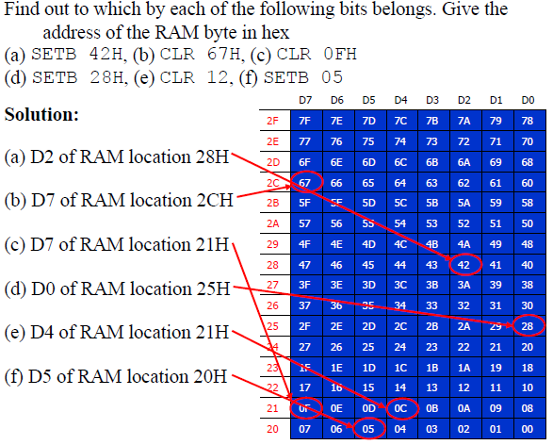

Slide 3
Addressing Mode
Various ways of accessing data are called addressing modes
  Immediate
  Register
  Direct
  Register indirect
  Indexed etc

Slide 4

Immediate Addressing Mode
The source operand is a constant
immediate data must be preceded by the pound sign, “#”
  Used to load information into any registers, including 16-bit DPTR register
4521H

Slide 5
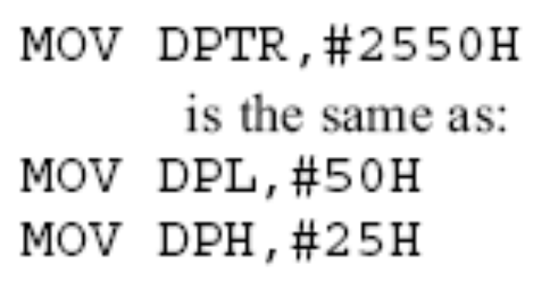
Immediate Addressing Mode (cont.)
DPTR can also be accessed as two 8-bit registers
  The high byte DPH and low byte DPL

Slide 6
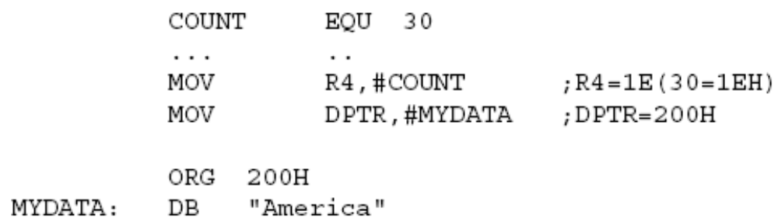
Immediate Addressing Mode (cont.)
We can use EQU directive to access immediate data
We can also use immediate addressing mode to send data to 8051 ports

Slide 7
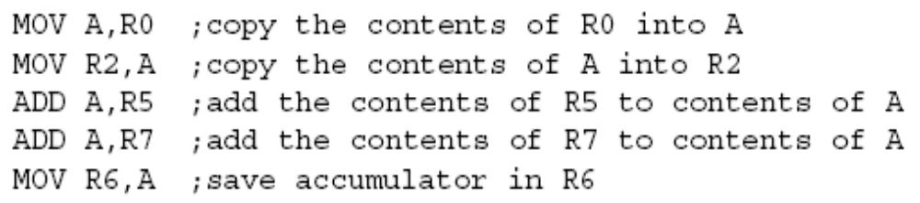
Register Addressing Mode
Use registers to hold the data to be manipulated
The source and destination registers must match in size
  MOV DPTR,A will give an error

Slide 8

Register Addressing Mode (cont.)
The movement of data between Rn registers is not allowed
  MOV R4, R7 is invalid

Slide 9

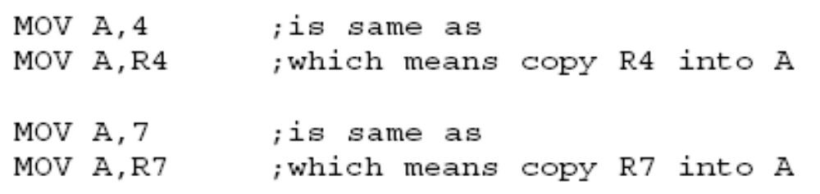
Direct Addressing Mode
Direct addressing mode to access RAM locations 30 – 7FH
The entire 128 bytes of RAM

Slide 10
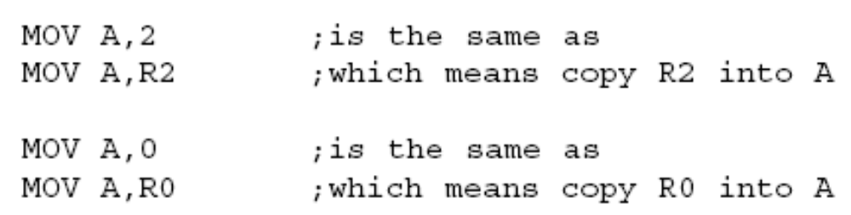
Direct Addressing Mode (cont.)
Contrast this with immediate addressing mode there is no “#” sign in the operand

Slide 11
SFR Registers and Their Addresses
The SFR (Special Function Register) can be accessed by their names or by their addresses
  The SFR registers have addresses between 80H and FFH
    Not all the address space of 80 to FF is used by SFR
    The unused locations 80H to FFH are reserved and must not be used by the 8051 programmer

Slide 12
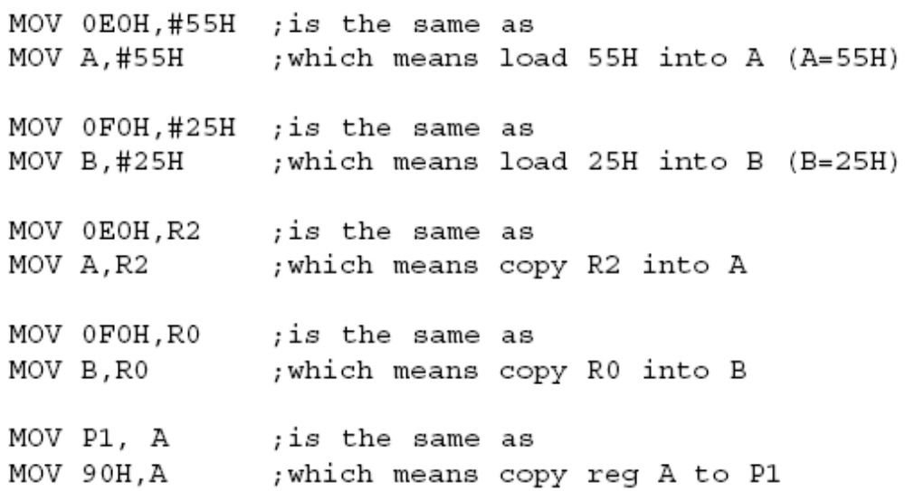
SFR Registers and Their Addresses (cont.)

Slide 13
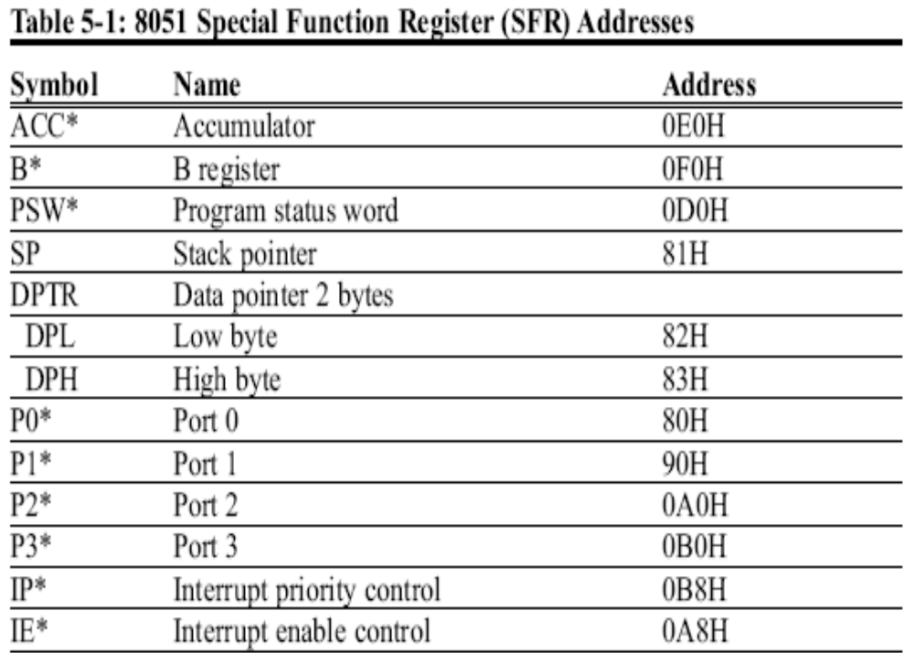
SFR Registers and Their Addresses (cont.)

Slide 14
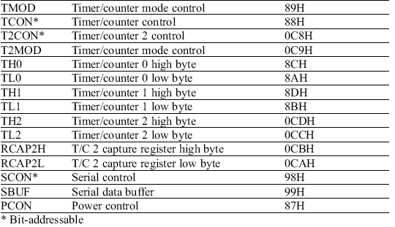
SFR Registers and Their Addresses (cont.)

Slide 15
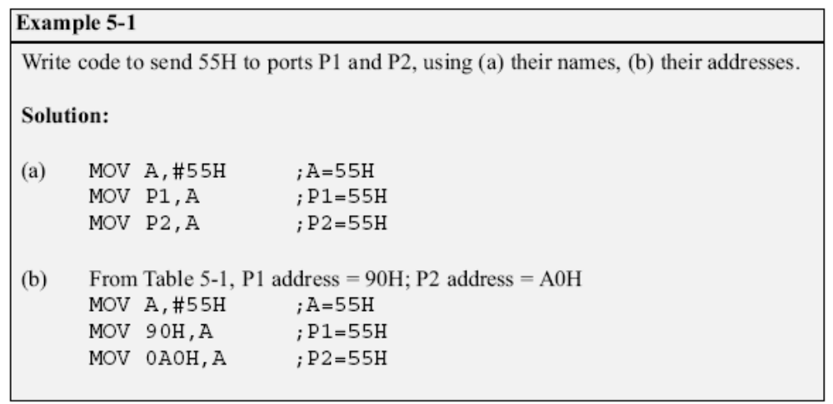
SFR Registers and Their Addresses (cont.)

Slide 16
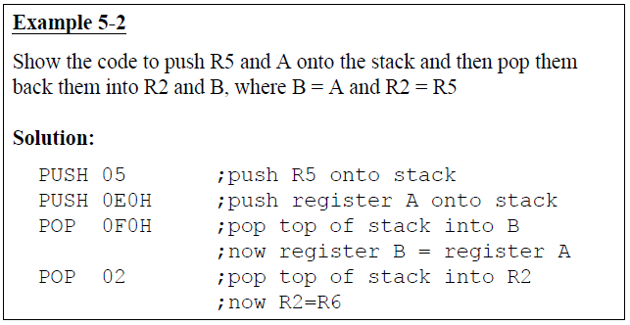
Stack and Direct Addressing
Mode
Only direct addressing mode is allowed for pushing or popping the stack
  PUSH A is invalid
    Pushing the accumulator onto the stack must be coded as PUSH 0E0H

Slide 17

Register Indirect Addressing Mode
A register is used as a pointer to the data
  Only register R0 and R1 are used for this purpose
  R2 – R7 cannot be used to hold the address of an operand located in RAM
    When R0 and R1 hold the addresses of RAM locations, they must be preceded by the “@” sign

Slide 18
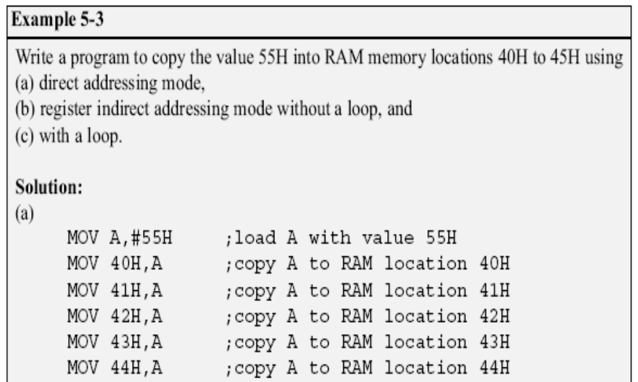

Slide 19
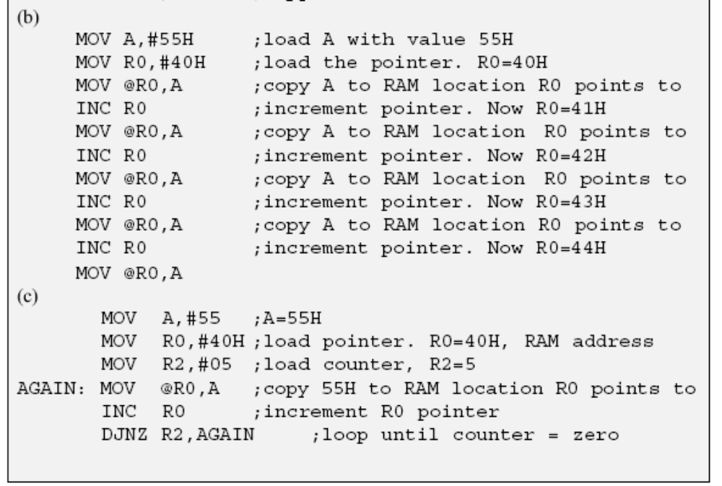

Slide 20
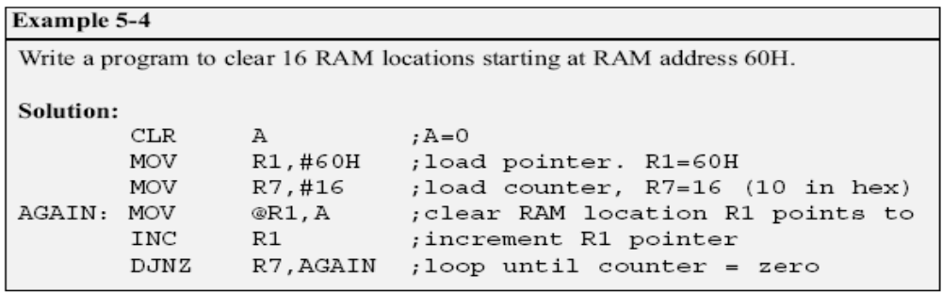
Register Indirect Addressing Mode (cont.)
The advantage is that it makes accessing data dynamic rather than static as in direct addressing mode
  Looping is not possible in direct addressing mode

Slide 21
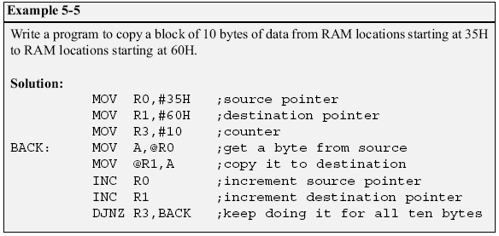
Register Indirect Addressing Mode (cont.)

Slide 22
Register Indirect Addressing Mode (cont.)
R0 and R1 are the only registers that can be used for pointers in register indirect addressing mode
  Since R0 and R1 are 8 bits wide, their use is limited to access any information in the internal RAM
Whether accessing externally connected RAM or on-chip ROM, we need 16-bit pointer
  In such case, the DPTR register is used

Slide 23
Indexed Addressing Mode and On-chip ROM Access
Indexed addressing mode is widely used in accessing data elements of look-up table entries located in the program ROM
  The instruction used for this purpose is
MOVC A,@A+DPTR
    Use instruction MOVC,
      “C” means code
    The contents of A are added to the 16-bit register DPTR to form the 16-bit address of the needed data

Slide 24
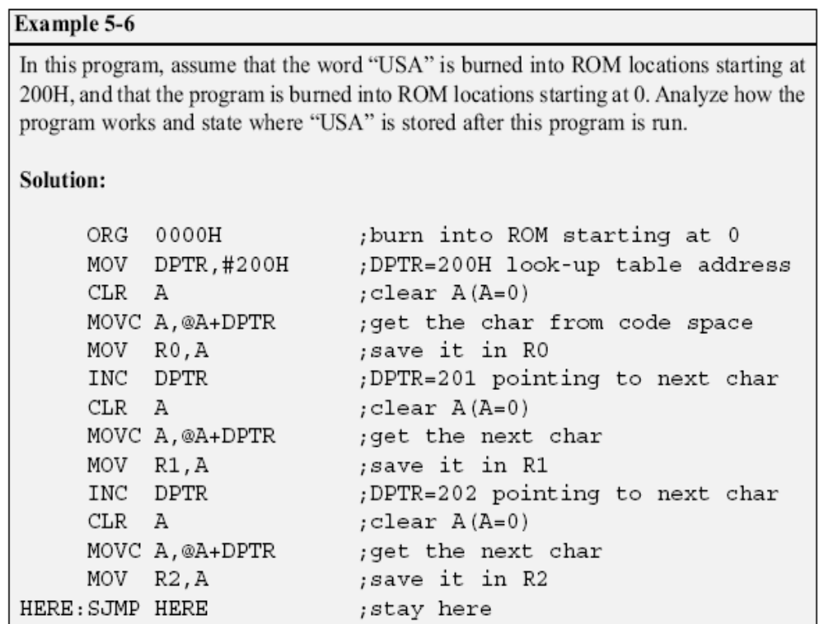

Slide 25
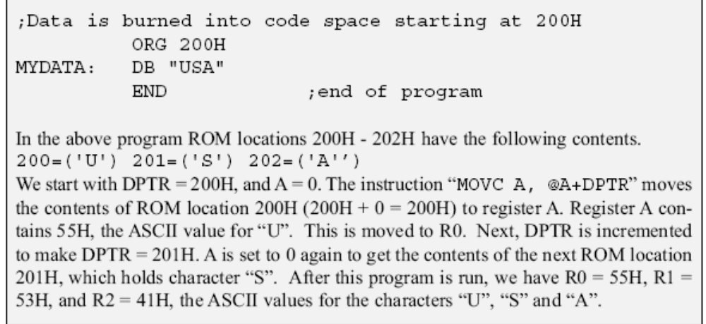

Slide 26
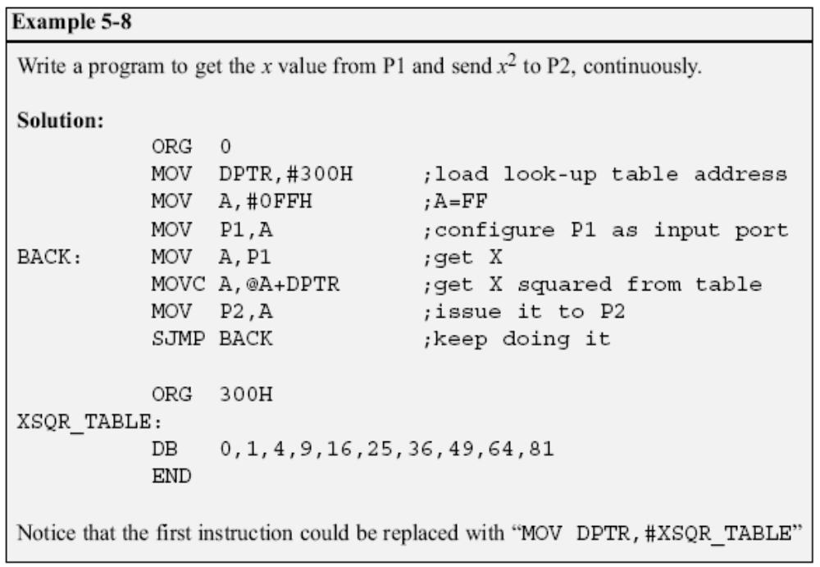
Look-up table and the MOVC instruction

Slide 27
Indexed Addressing Mode and MOVX
In many applications, the size of program code does not leave any room to share the 64K-byte code space with data
  The 8051 has another 64K bytes of memory space set aside exclusively for data storage
    This data memory space is referred to as external memory and it is accessed only by the MOVX instruction
    The 8051 has a total of 128K bytes of memory space
      64K bytes of code and 64K bytes of data
      The data space cannot be shared between code and data

Slide 28
RAM Locations 30 – 7FH as Scratch Pad
In many applications we use RAM locations 30 – 7FH as scratch pad
  We use R0 – R7 of bank 0
  Leave addresses 8 – 1FH for stack usage
  If we need more registers, we simply use RAM locations 30 – 7FH

Slide 29
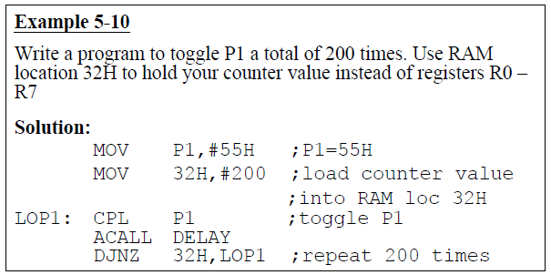
RAM Locations 30 – 7FH as Scratch Pad (cont.)

Slide 30
Bit Addresses
Many microprocessors allow program to access registers and I/O ports in byte size only
  In many applications we need to check a single bit
One unique and powerful feature of the 8051 is single-bit operation
  Single-bit instructions allow the programmer to set, clear, move, and complement individual bits of a port, memory, or register

Slide 31
Bit Addresses (cont.)
  It is registers, RAM, and I/O ports that need to be bit-addressable
  ROM, holding program code for execution, is not bit-addressable

Slide 32
Bit-Addressable RAM
The bit-addressable RAM location are 20H to 2FH
  These 16 bytes provide 128 bits of RAM bit-addressability, since 16 × 8 = 128
    0 to 127 (in decimal) or 00 to 7FH
    The first byte of internal RAM location 20H has bit address 0 to 7H
    The last byte of 2FH has bit address 78H to 7FH
Internal RAM locations 20-2FH are both byte-addressable and bit-addressable

Slide 33
Bit-Addressable RAM (cont.)
  Bit address 00-7FH belong to RAM byte addresses 20-2FH
  Bit address 80-F7H belong to SFR P0, P1, …
To avoid confusion regarding the addresses 00 – 7FH
  The 128 bytes of RAM have the byte addresses of 00 – 7FH can be accessed in byte size using various addressing modes
    Direct and register-indirect

Slide 34
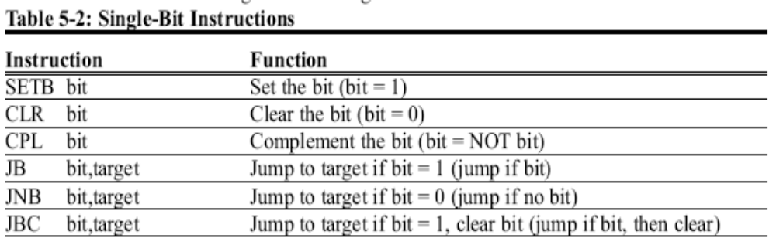
Bit-Addressable RAM (cont.)
  The 16 bytes of RAM locations 20 – 2FH have bit address of 00 – 7FH
    We can use only the single-bit instructions
    These instructions use only direct addressing mode

Slide 35
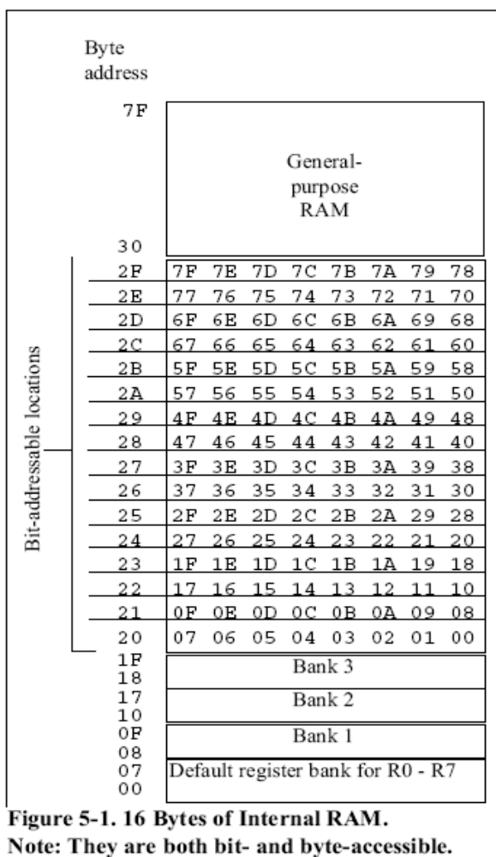

Slide 36
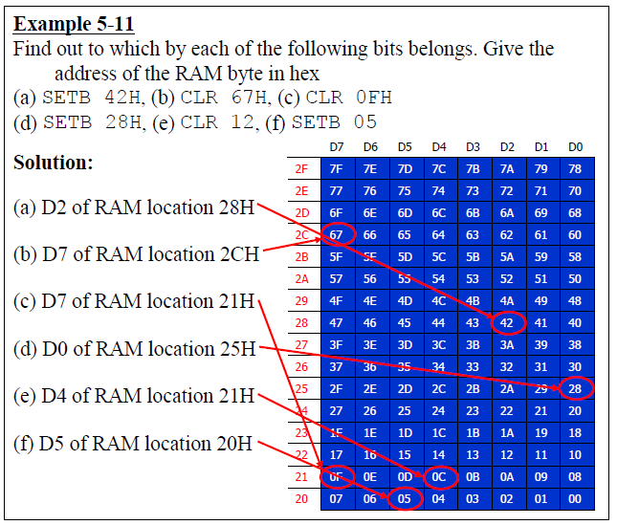

Slide 37
I/O Port Bit Addresses
While all of the SFR registers are byte-addressable, some are also bit-addressable
  The P0 – P3 are bit addressable
    We can access either the entire 8 bits or any single bit of I/O ports P0, P1, P2, and P3 without altering the rest
      When accessing a port in a single-bit manner, we use the syntax SETB X.Y
      X is the port number P0, P1, P2, or P3
      Y is the desired bit number from 0 to 7 for data bits D0 to D7
      ex. SETB P1.5 sets bit 5 of port 1 high

Slide 38
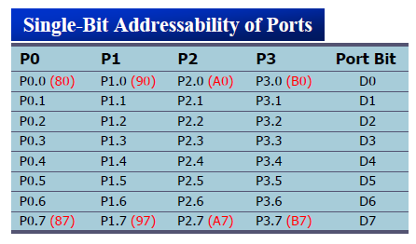
I/O Port Bit Addresses (cont.)
    When code such as SETB P1.0 is assembled, it becomes SETB 90H
    The bit address for I/O ports
      P0 are 80H to 87H
      P1 are 90H to 97H
      P2 are A0H to A7H
      P3 are B0H to B7H

Slide 39
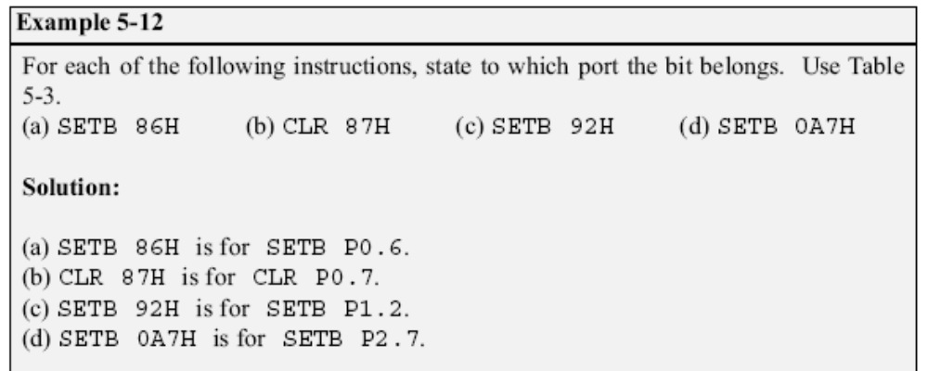

Slide 40
Registers Bit-Addressability
Only registers ACC (A), B, PSW, IP, IE, SCON, and TCON are bit-addressable
  While all I/O ports are bit-addressable
In PSW register, two bits are set aside for the selection of the register banks
  Upon RESET, bank 0 is selected
  We can select any other banks using the bit-addressability of the PSW

Slide 41
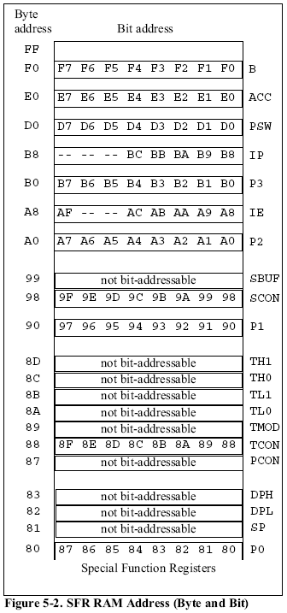


Slide 42
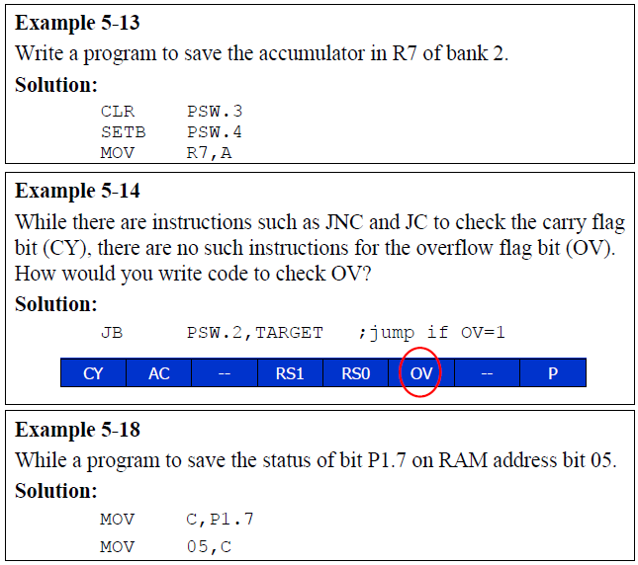

Slide 43
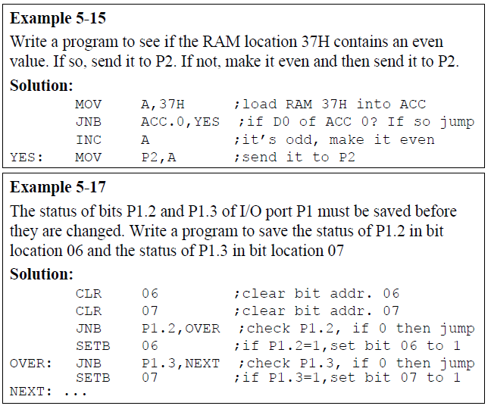

Slide 44
Using BIT & EQU
The BIT directive is a widely used directive to assign the bit-addressable I/O and RAM locations
  Allow a program to assign the I/O or RAM bit at the beginning of the program
    Making it easier to modify them
Use the EQU to assign addresses
  Defined by names, like P1.7 or P2
  Defined by addresses, like 97H or 0A0H

Slide 45
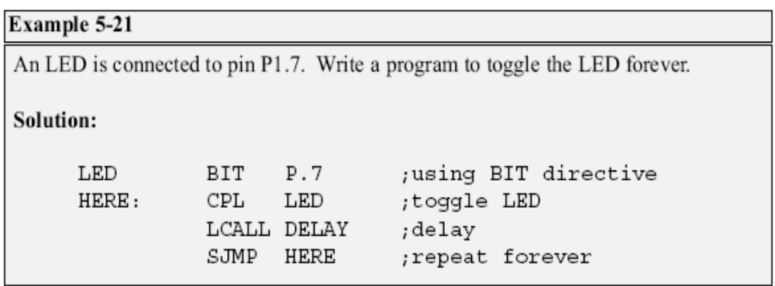
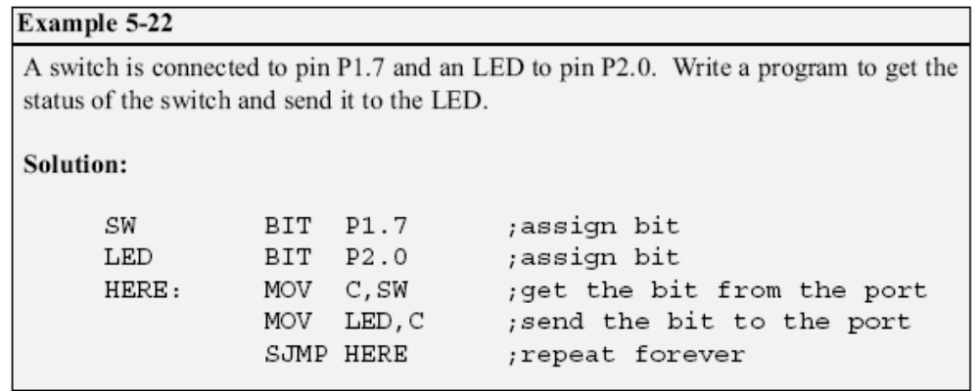
P1.7

Slide 46
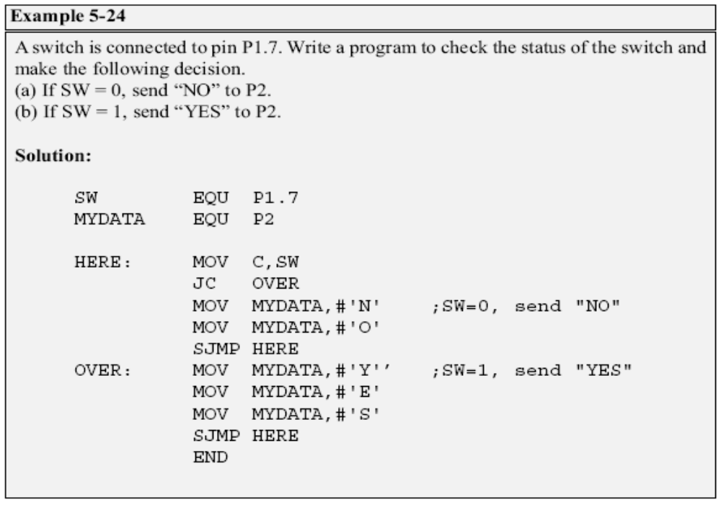

Slide 47
Extra 128 Byte On-Chip RAM in 8052
The 8052 has another 128 bytes of on-chip RAM with addresses 80 – FFH
  It is often called upper memory
    Use indirect addressing mode, which uses R0 and R1 registers as pointers with values ≧ 80H
MOV @R0, A and MOV @R1, A
  The same address space assigned to the SFRs
    Use direct addressing mode
    MOV 90H, #55H is the same as MOV P1, #55H

Slide 48
